Slide 1


LANL Team Update
11/15/2024
Izzy Baumler, Dalton Boeckmann, Morgan Gullo, Jade Waldron

Slide 2
Logistic Updates
All members have finished Red Badge Training and have received their badge to have access to all Manufacturing and Machining tools on campus
Confirmed a space of a 4’x4’ table for next Semester
Final Presentation scheduled for November 25th in Room 256 in Zachry Engineering Building (4 team members plus Dr. Darbha)

Slide 3
Mission Statement
There is a need for a technology that has 6 DOF and can move through its full range of motion in each degree of freedom of at least 1 Hz.

Slide 4
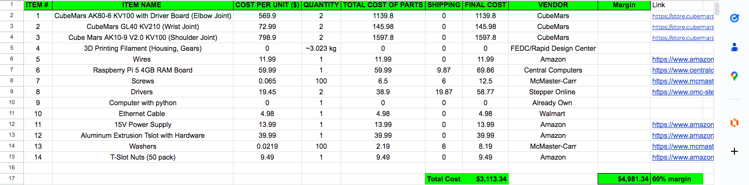
Preliminary Bill of Materials

Slide 5
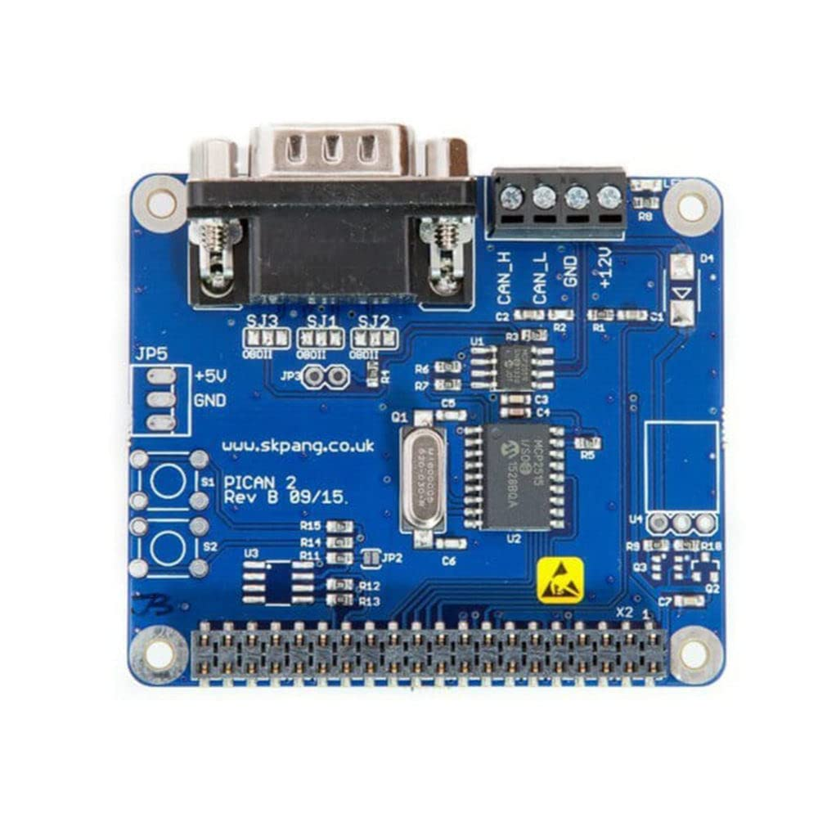
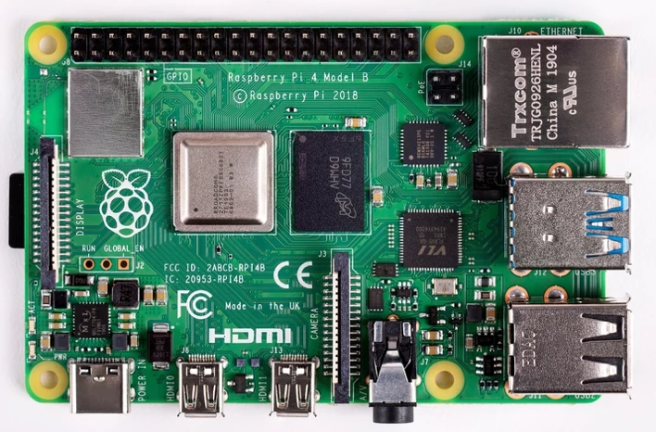
BOM

Slide 6
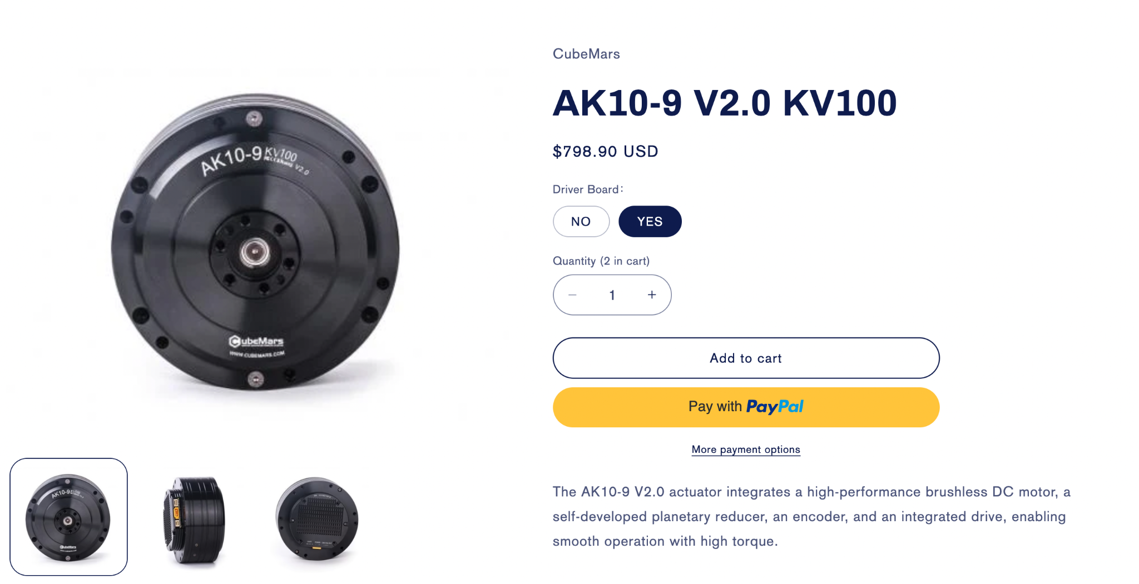
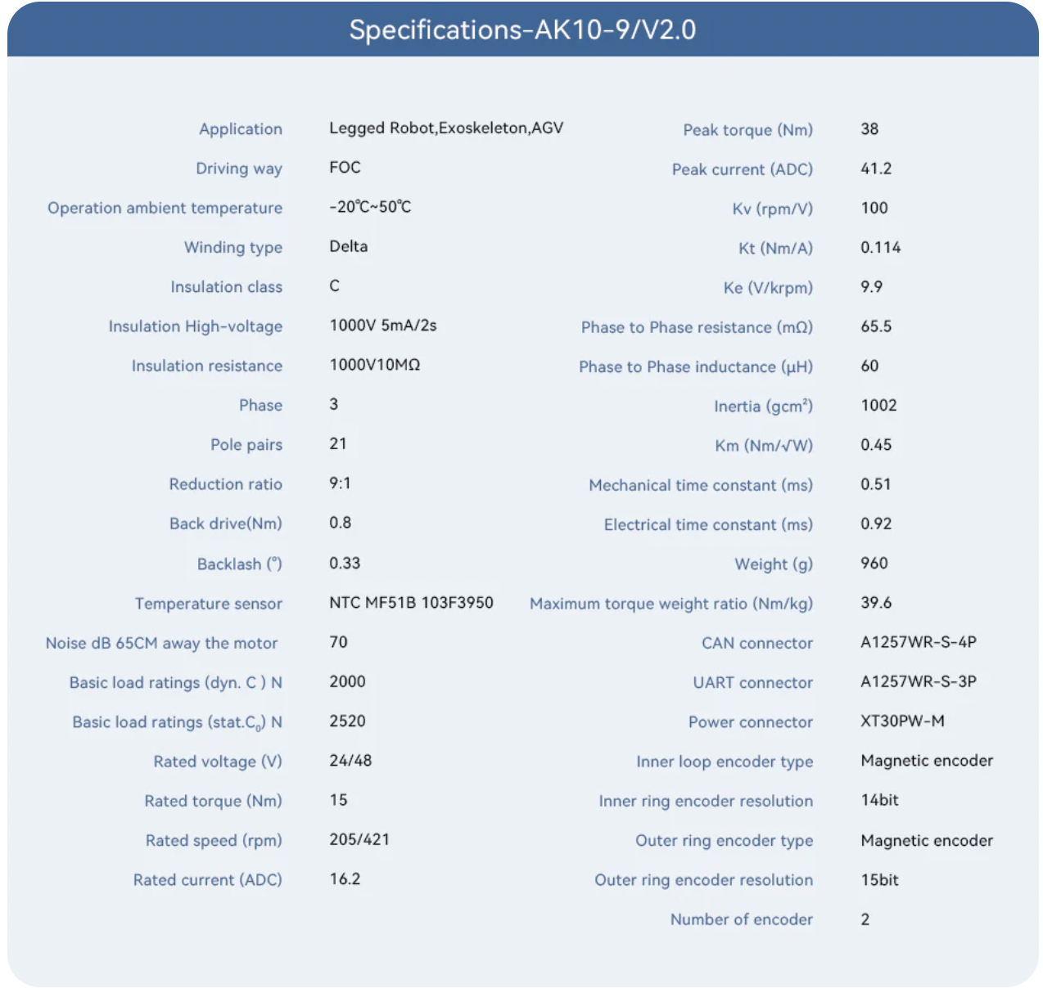
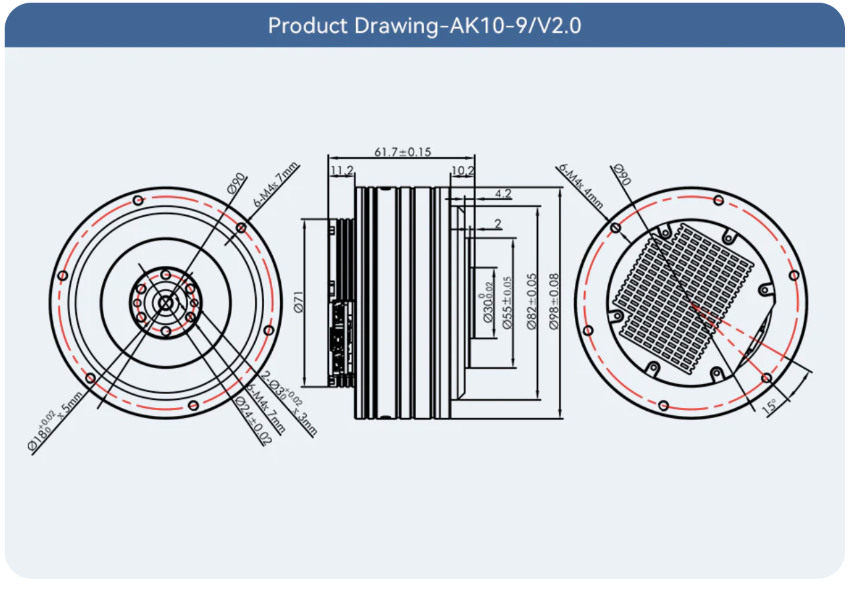
Shoulder Joint Motor

Slide 7
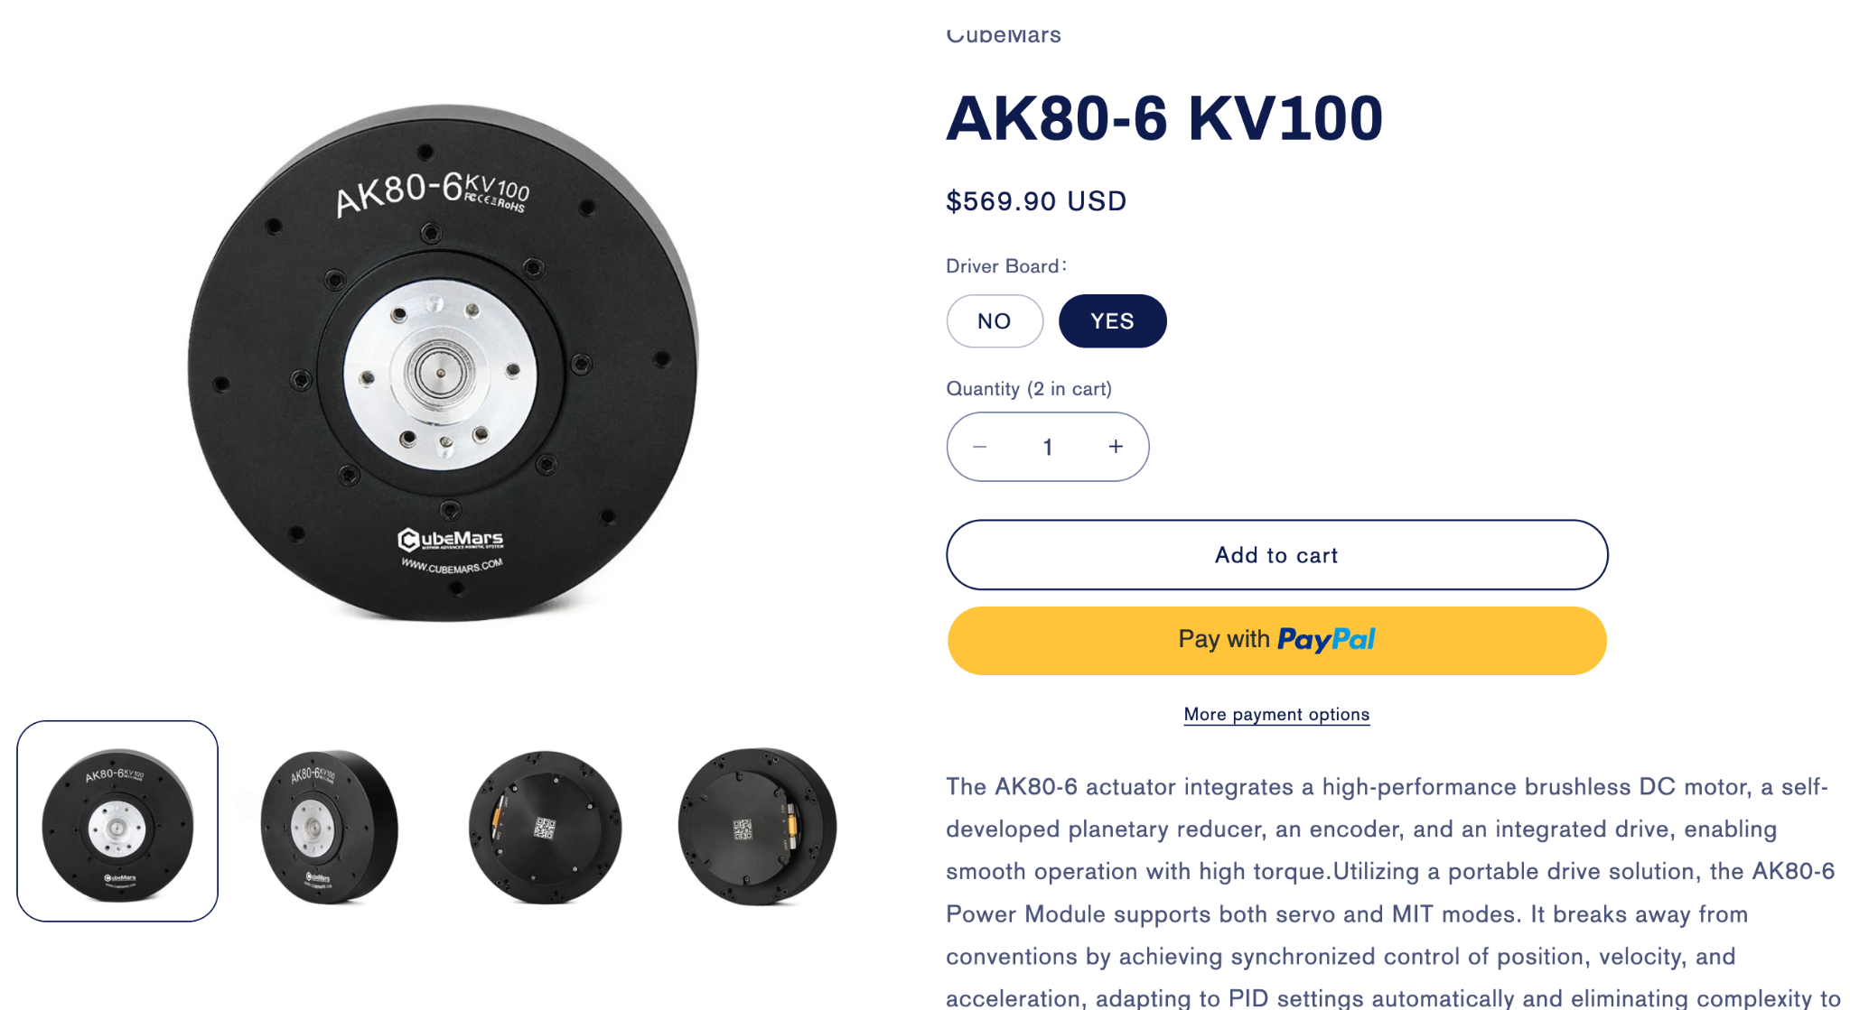
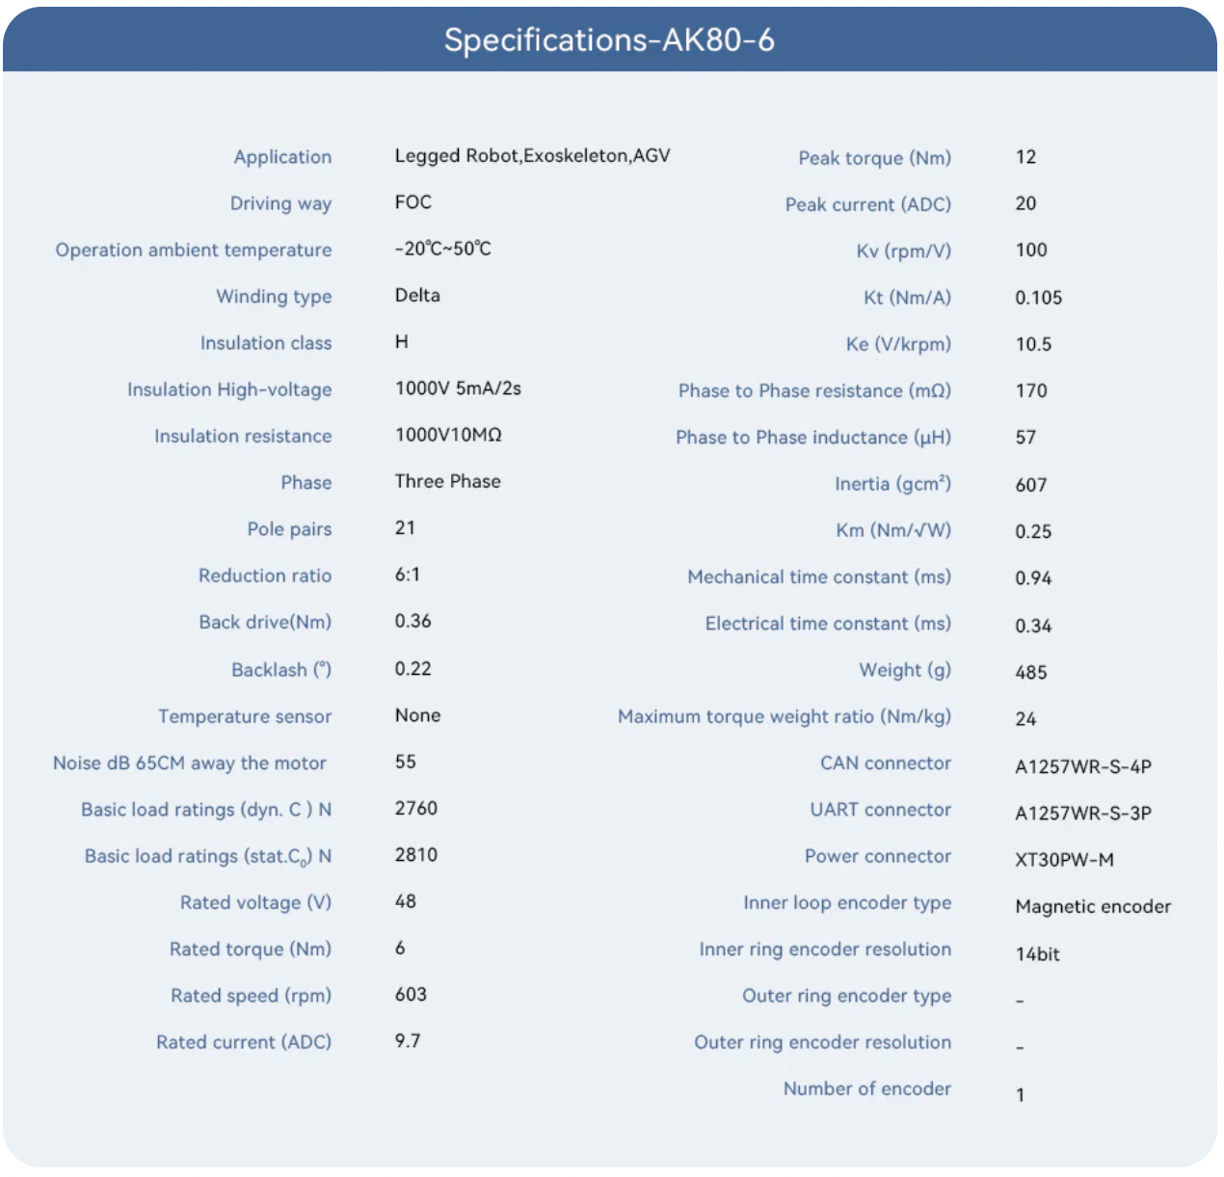
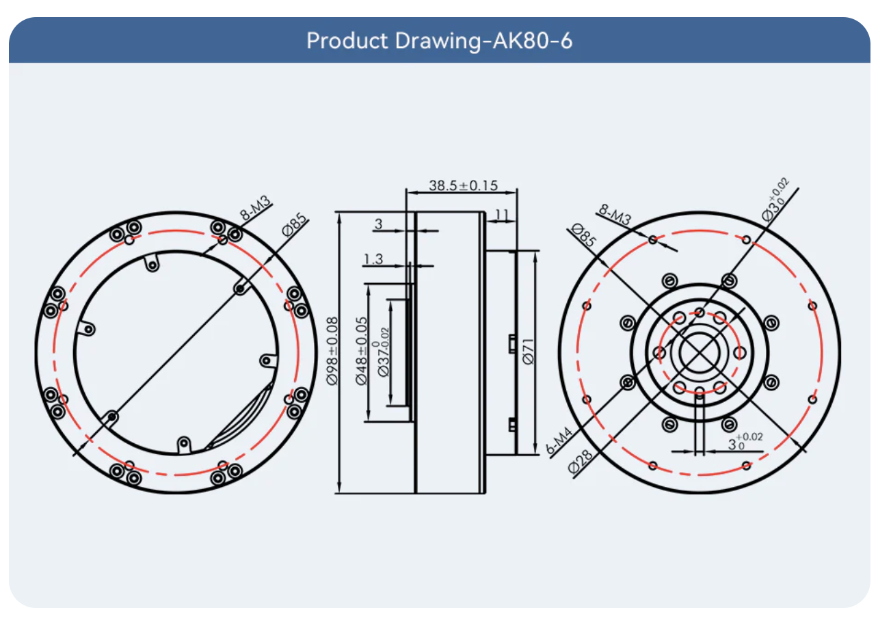
Elbow Joint Motor

Slide 8
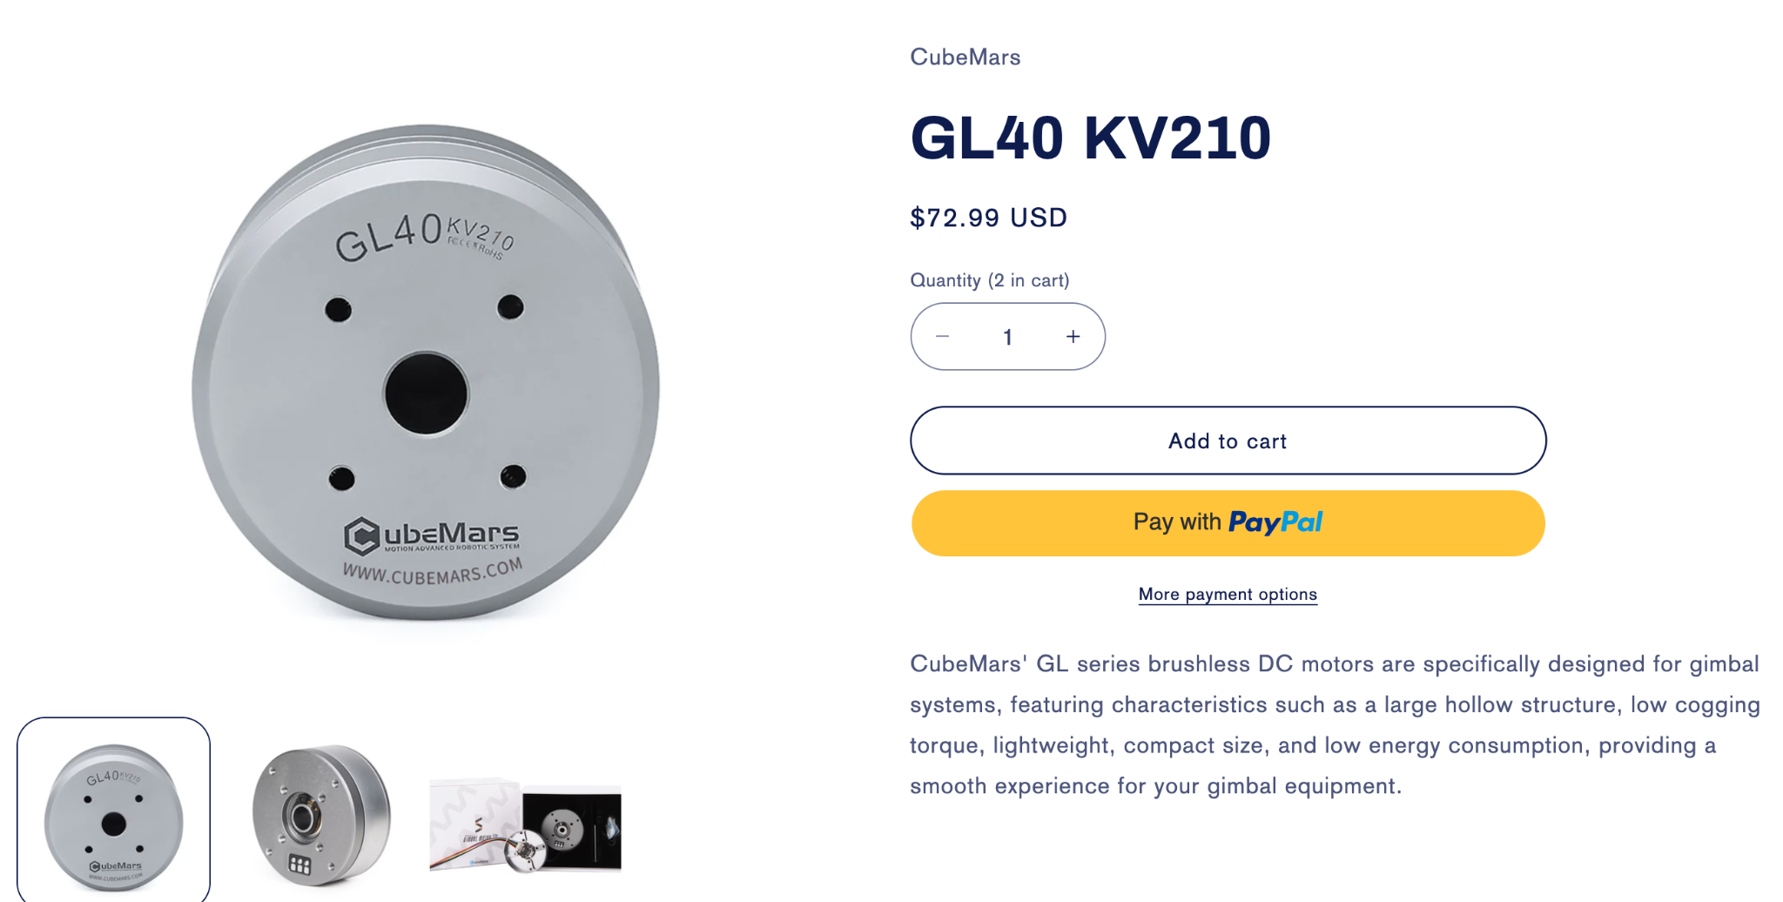
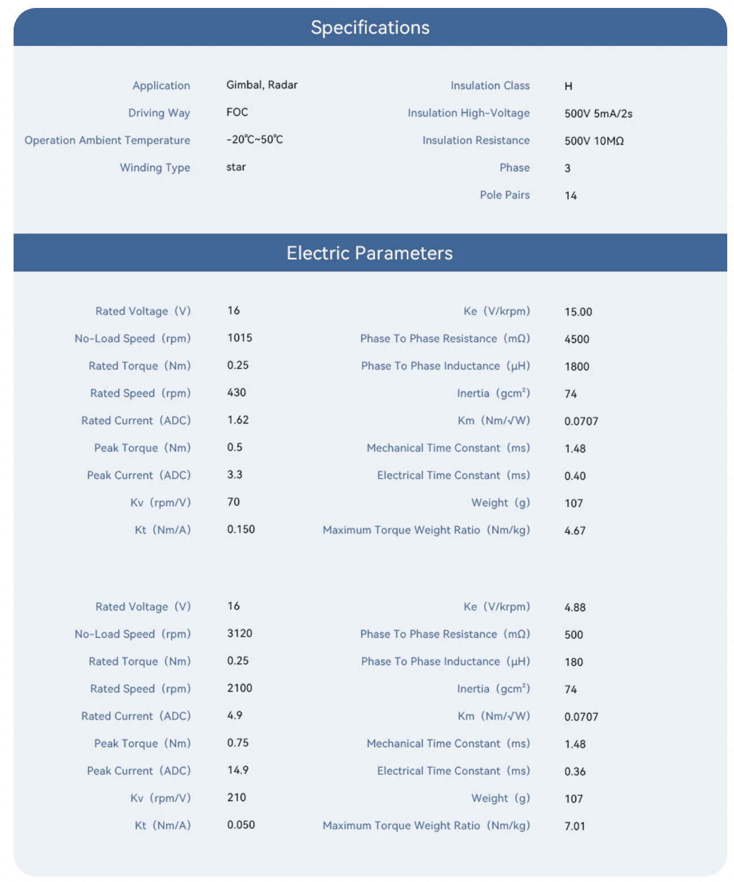
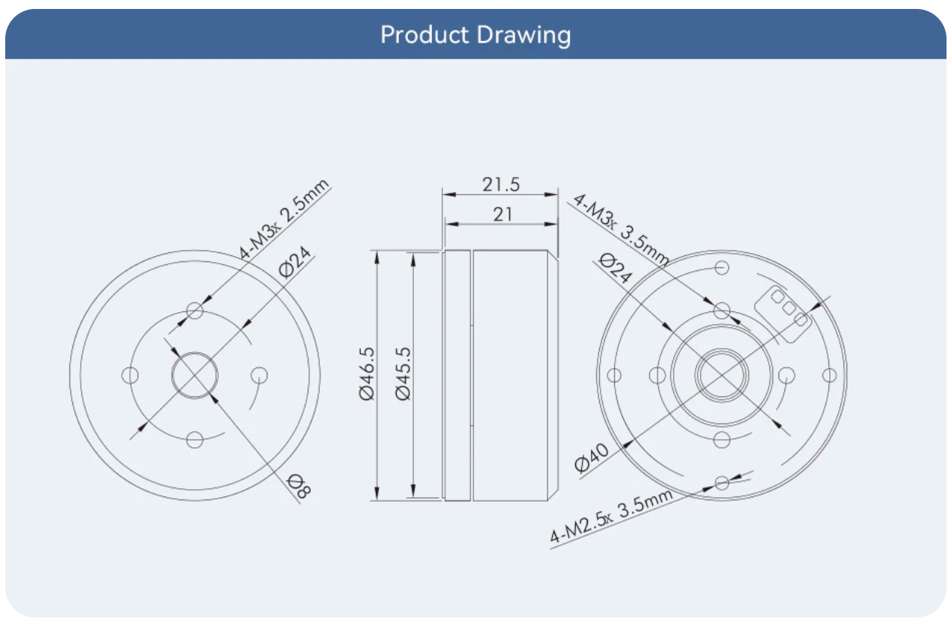
Wrist Joint Motor

Slide 9
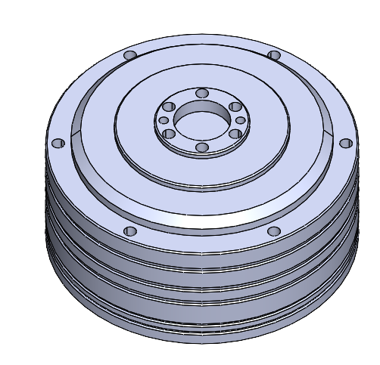
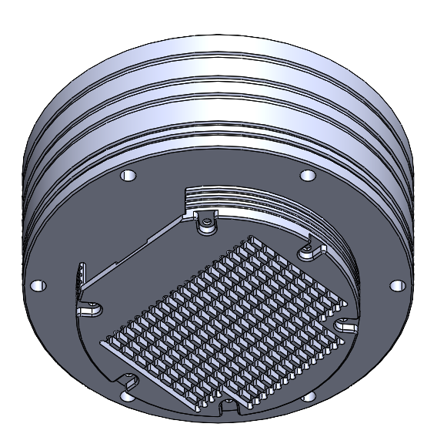
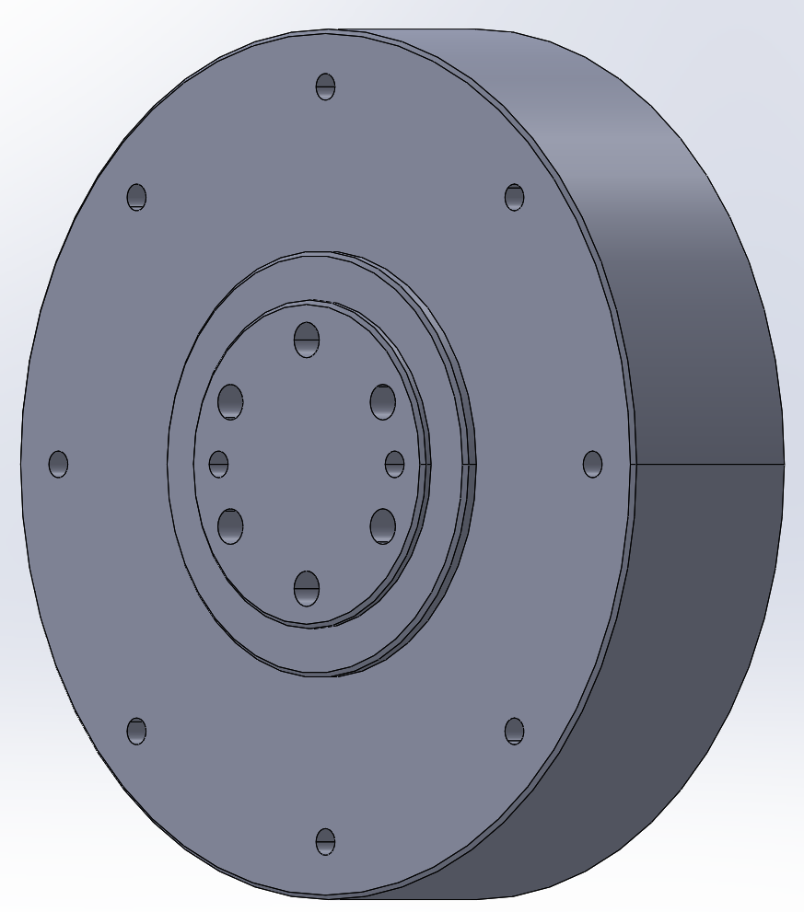
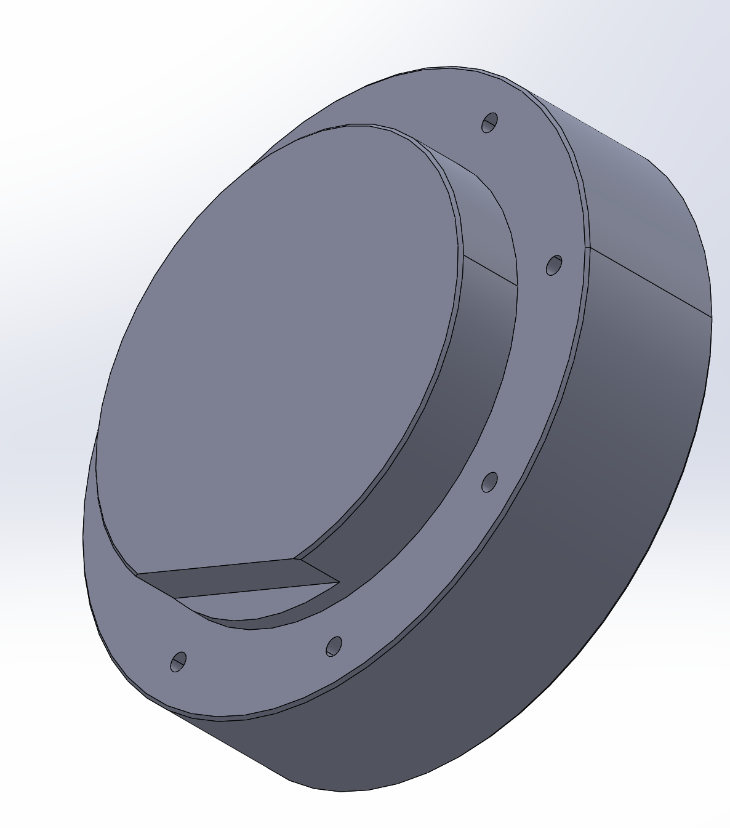
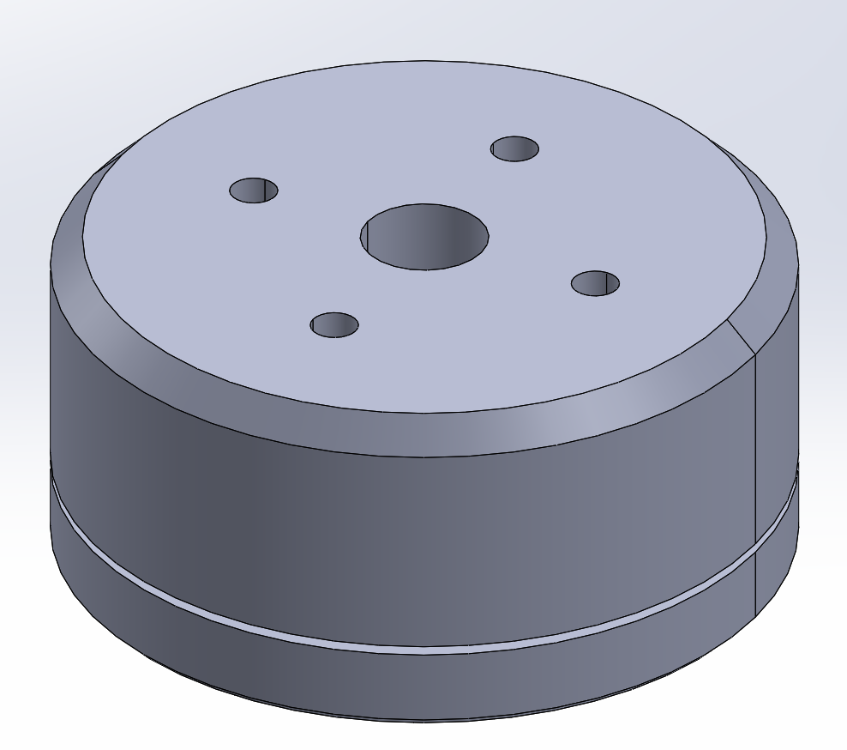
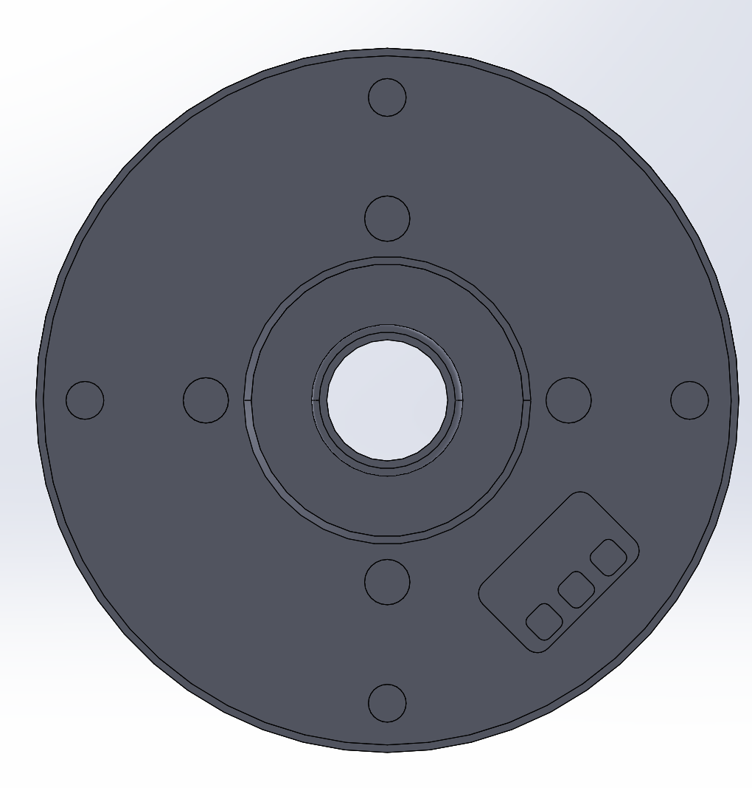
Detailed CAD - Joint Motor(s)
Reached out to CubeMars and asked for detailed CAD models of motors
Started incorporating models into Assembly

Slide 10
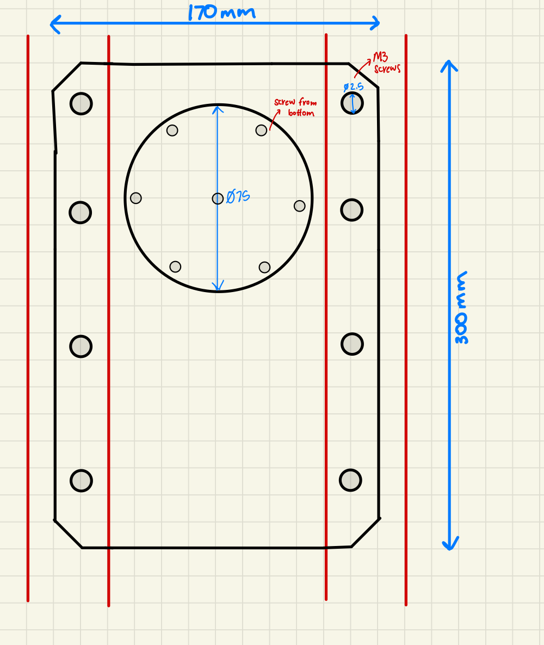
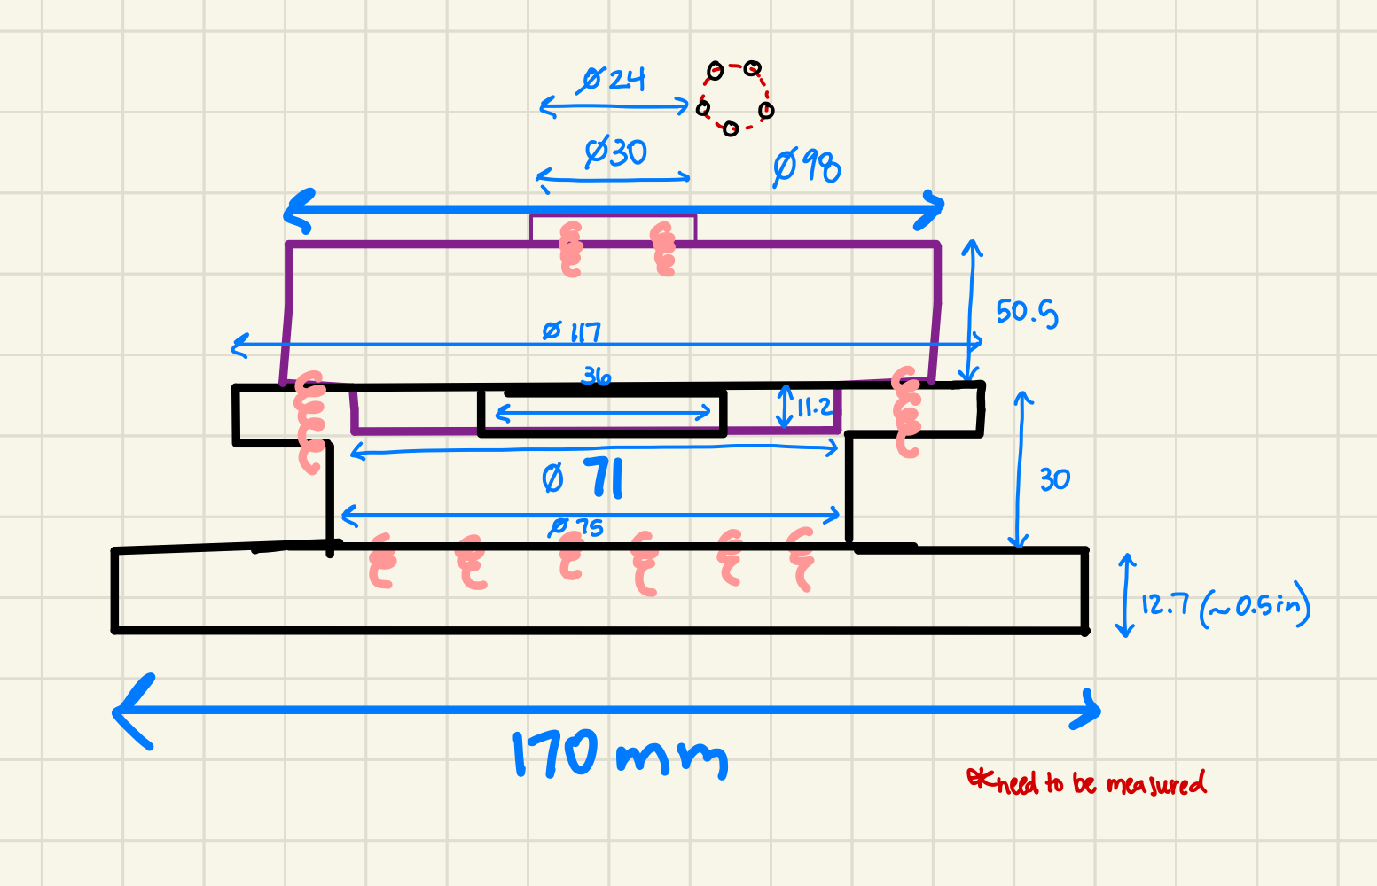
Detailed Drawings

Slide 11
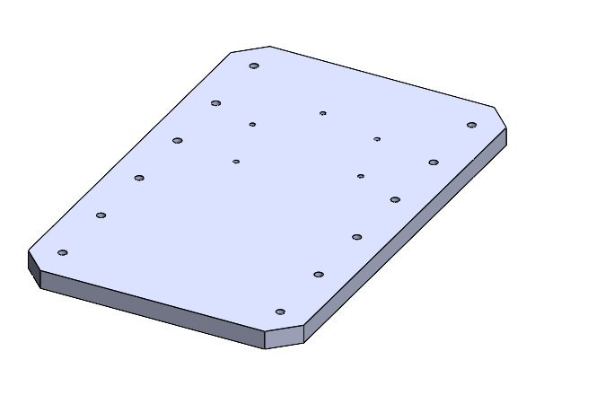
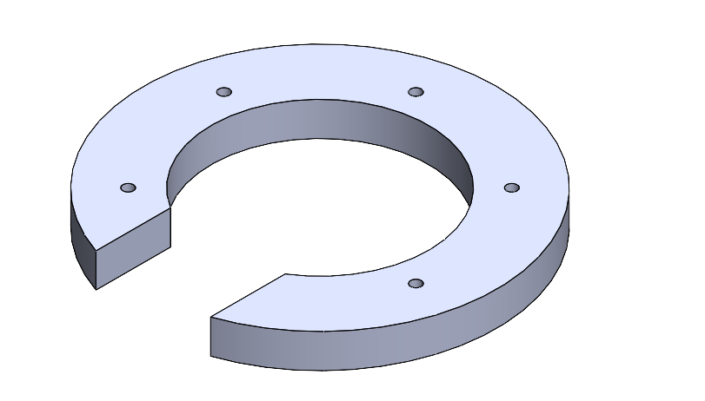
Detailed CAD - Base

Slide 12
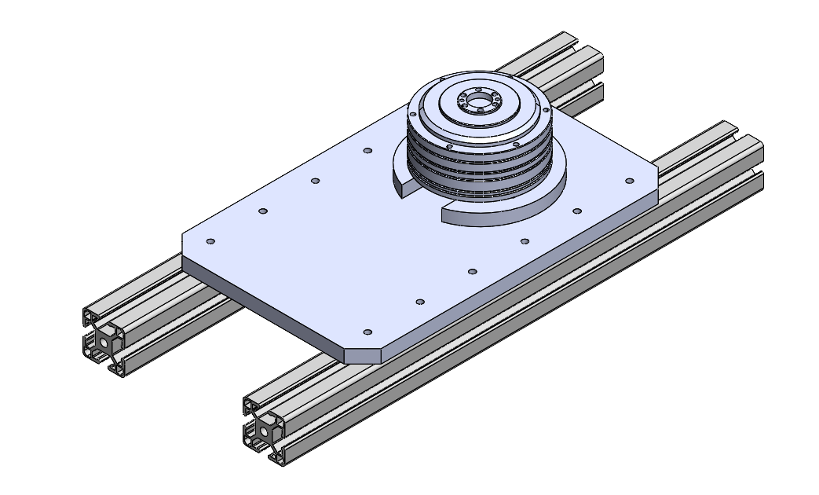
Detailed CAD - Base

Slide 13
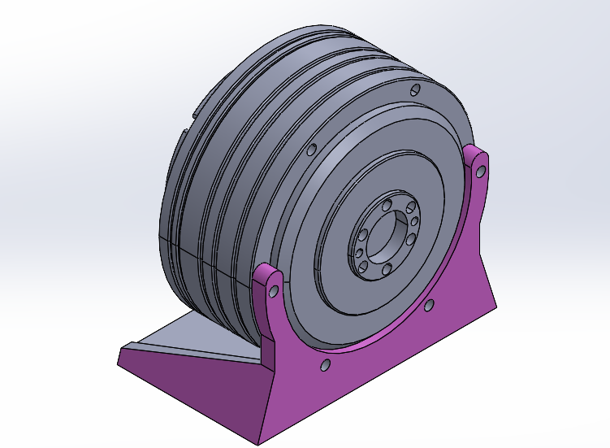
CAD - Shoulder

Slide 14
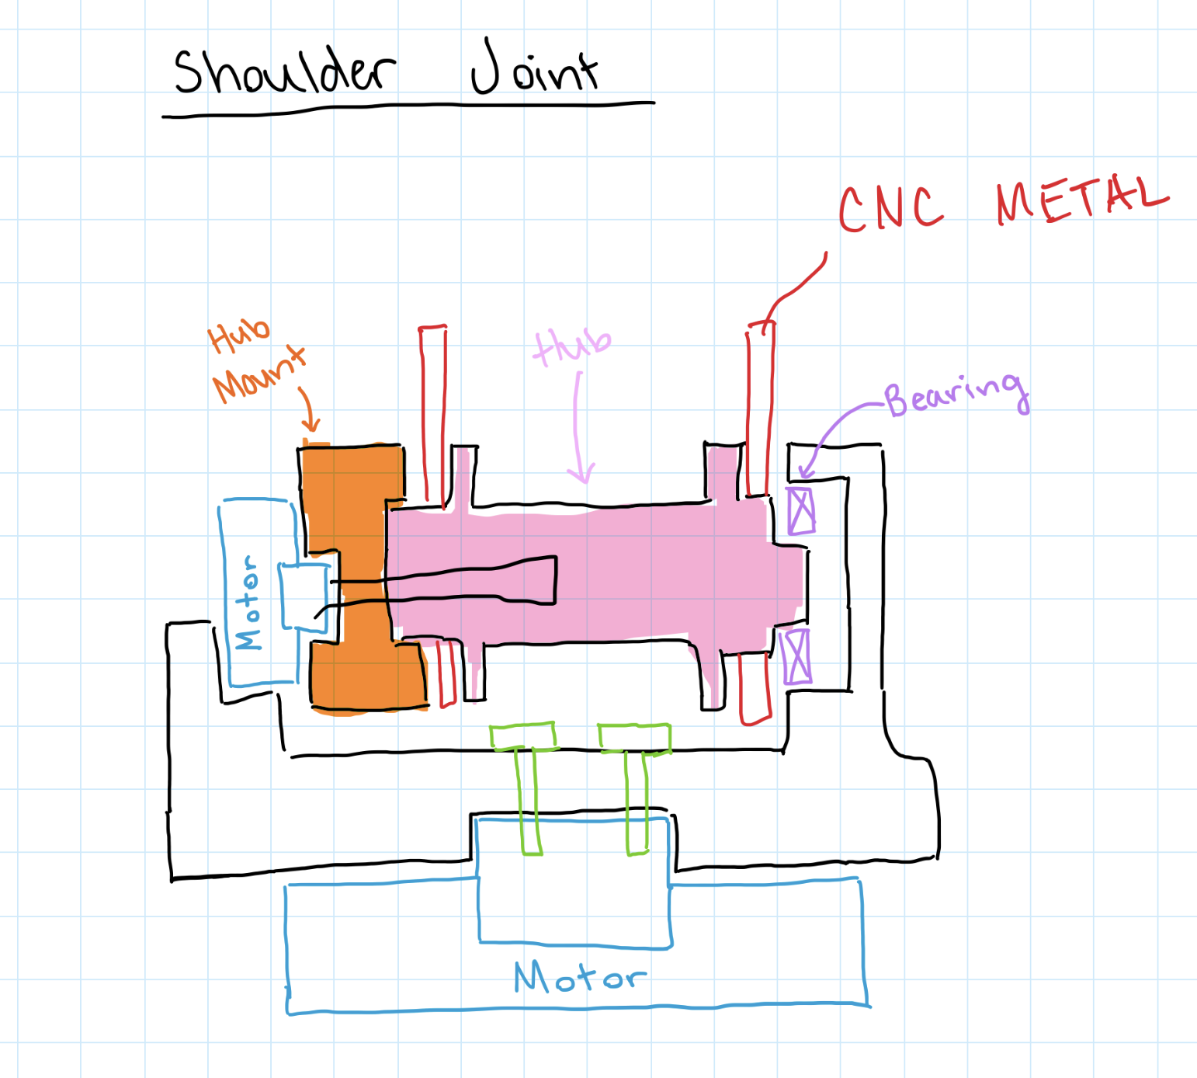
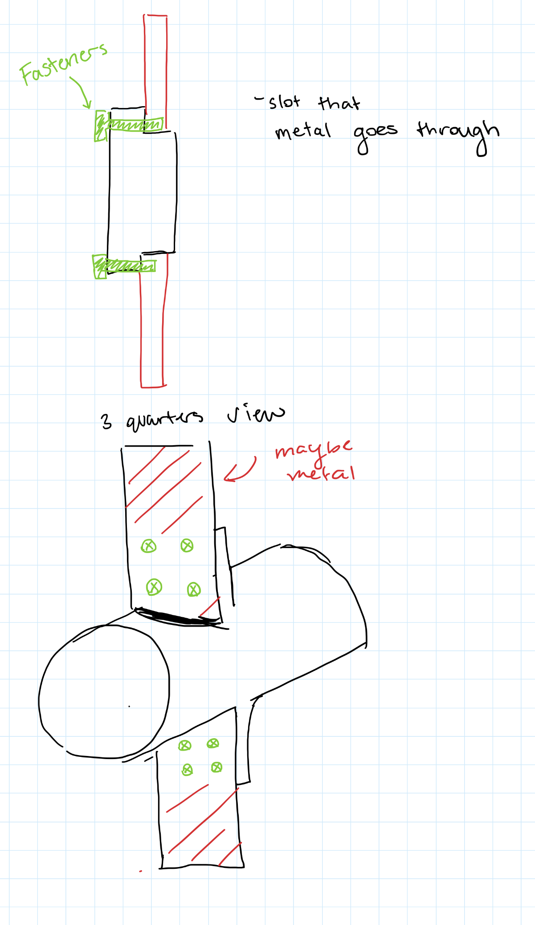
Detailed Drawings

Slide 15
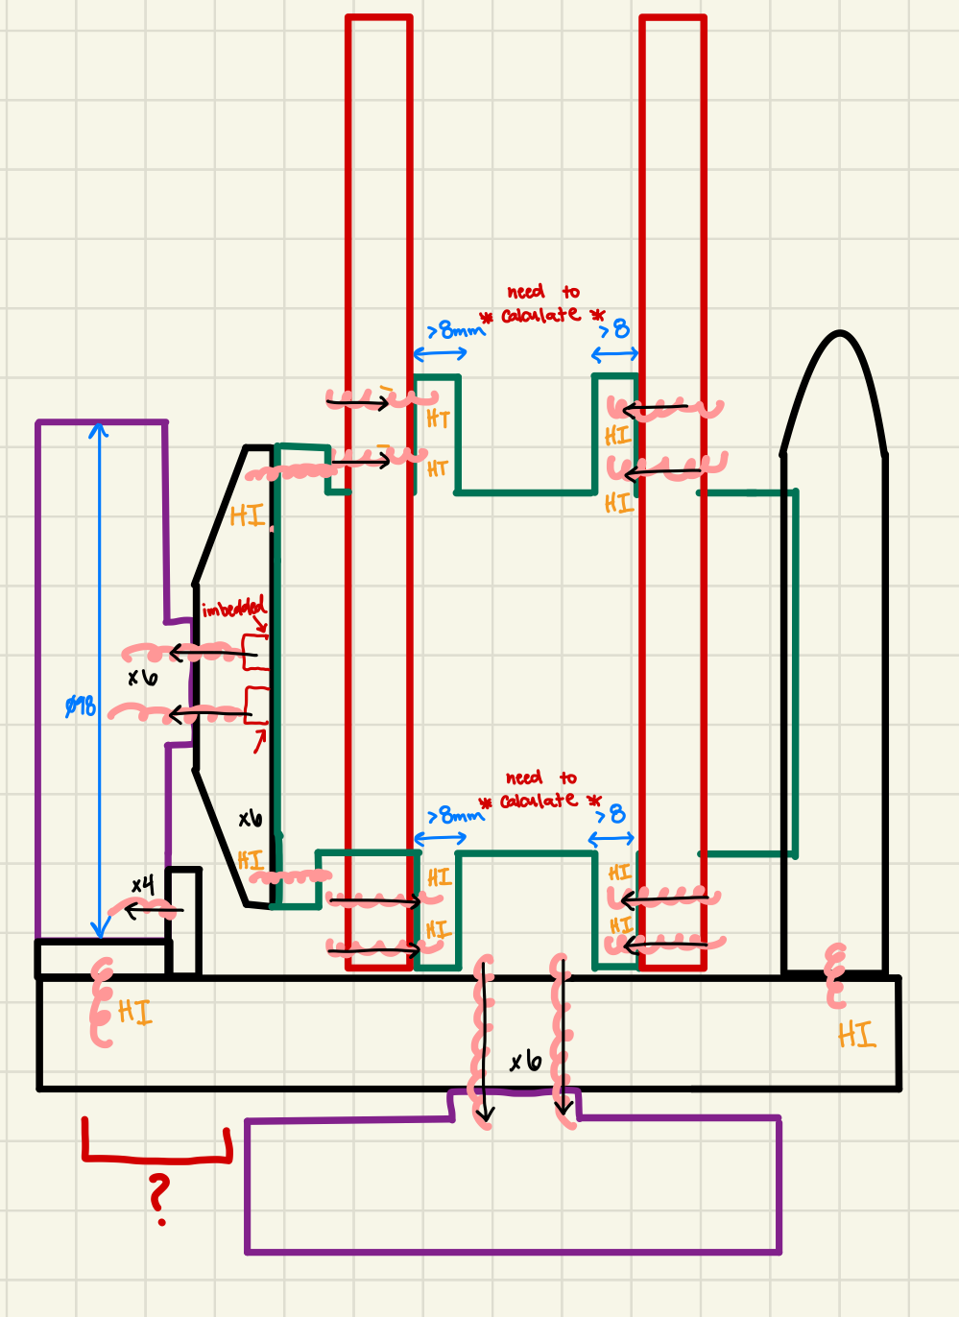
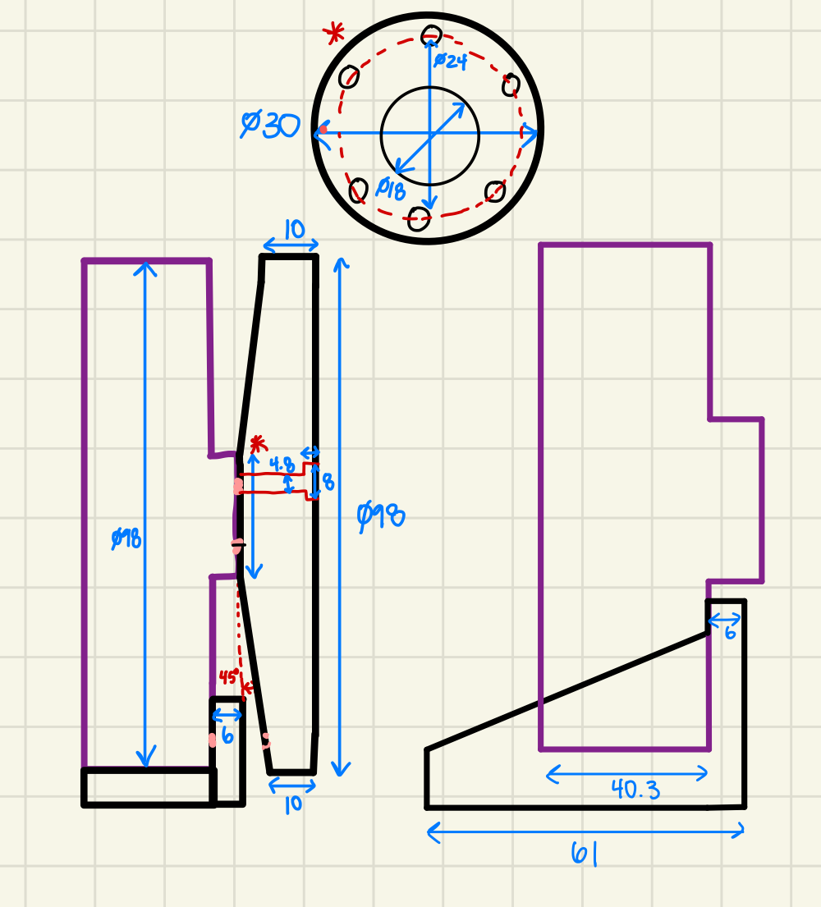
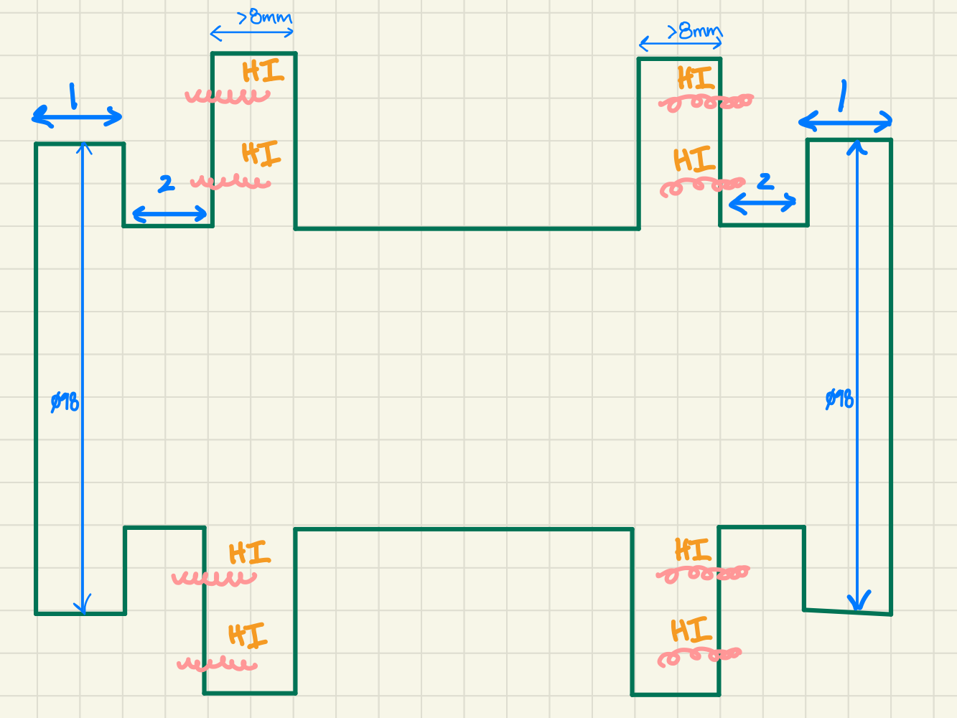
Detailed Drawings

Slide 16
Validation Plan - Brainstorming
The team began brainstorming ideas for the Validation Plan that we are going to execute next semester:
Finite Element Analysis (FEA) to see the amount of payload the arm can support without straining or seizing the motors
Inspect all joints to ensure they are free from any obstructing components
Implement initial codes for small translational/rotational movements to validate the motor inputs correspond with the output performance
Validate each motor one at a time before trying to perform movements with multiple at once
Verify each joint speed to confirm the achieved frequency
Calculate the total arm weight and confirm with scale measurement

Slide 17
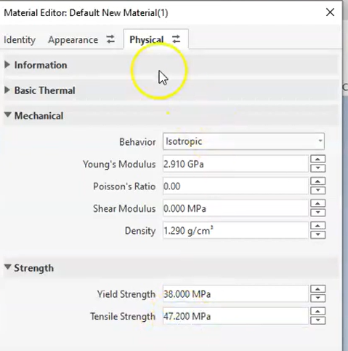
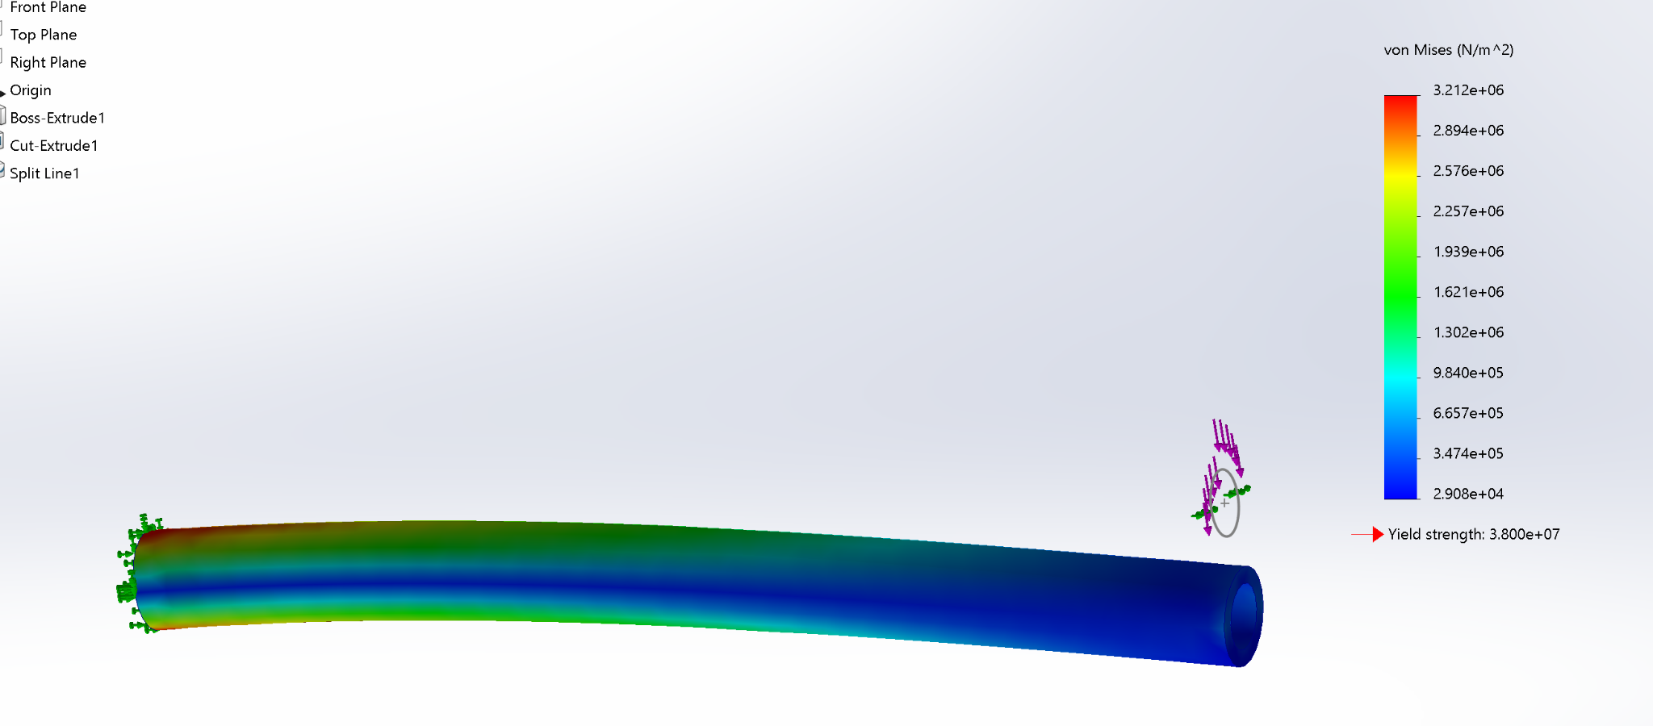
Validation Plan
FEA simulation shows:
von Mises, displacement, and strain
Von Mises

Slide 18
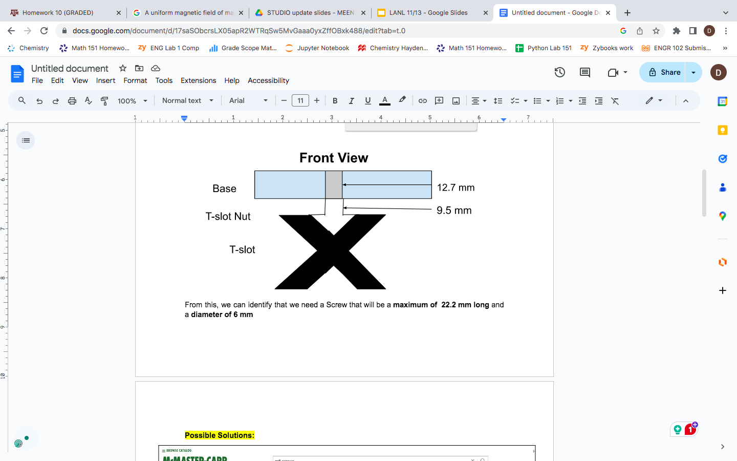
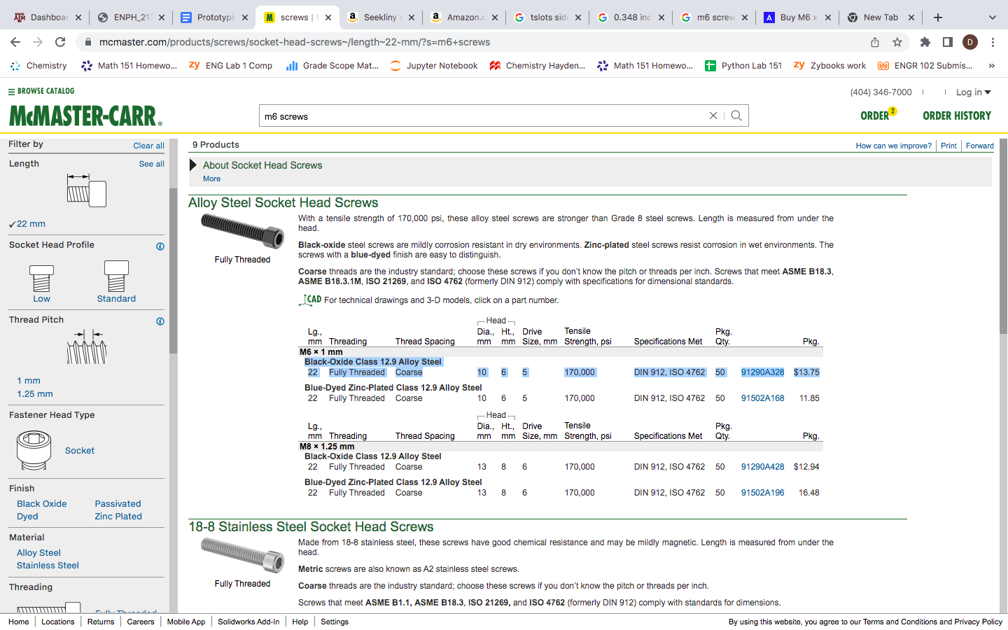
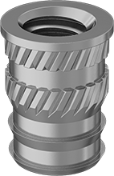
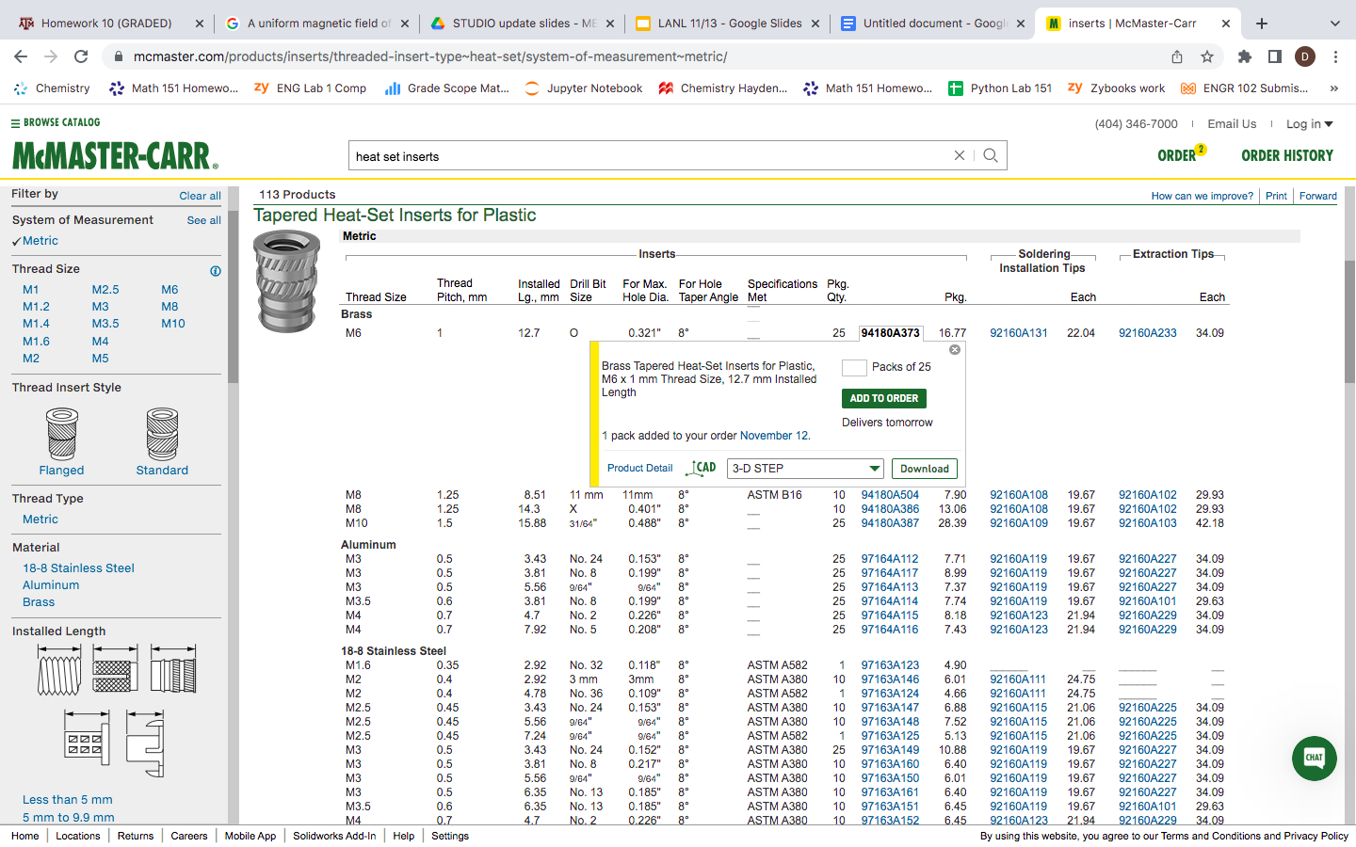
Fasteners
Screw Selection Process (M4, M6), vary in lengths
Fastener Analysis
T-Slot 40mmx40mm
Specified Base and Motor 1 Fasteners, working bottom up to account for all components
Notes:
Dalton:
Why we need Heat Set Inserts
Need to be Soldered
Why the screws need to be specific lengths
WHy we need M6 and M4 (compatibility with Different motors and Base)
Fastener analysis huge factor of our design
Talk about Tslot nuts
Why we had to increase to 40x40 Extrusions
You can help explain in the drawings with morgan and Izzy how we plan on securing certain fasteners to motors/3D printed parts

Slide 19
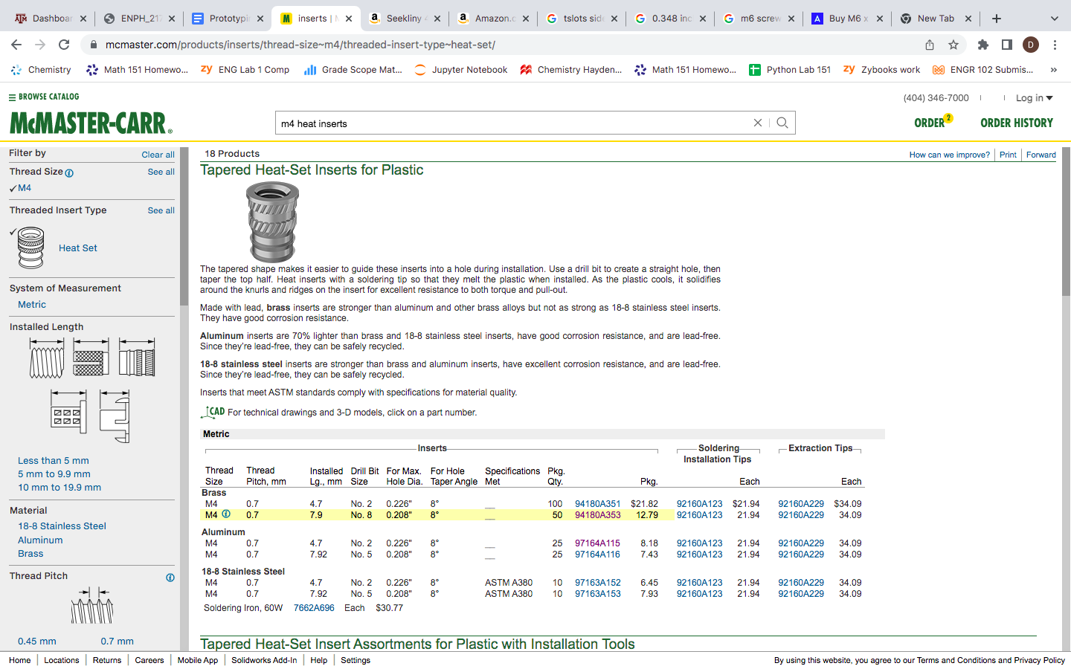
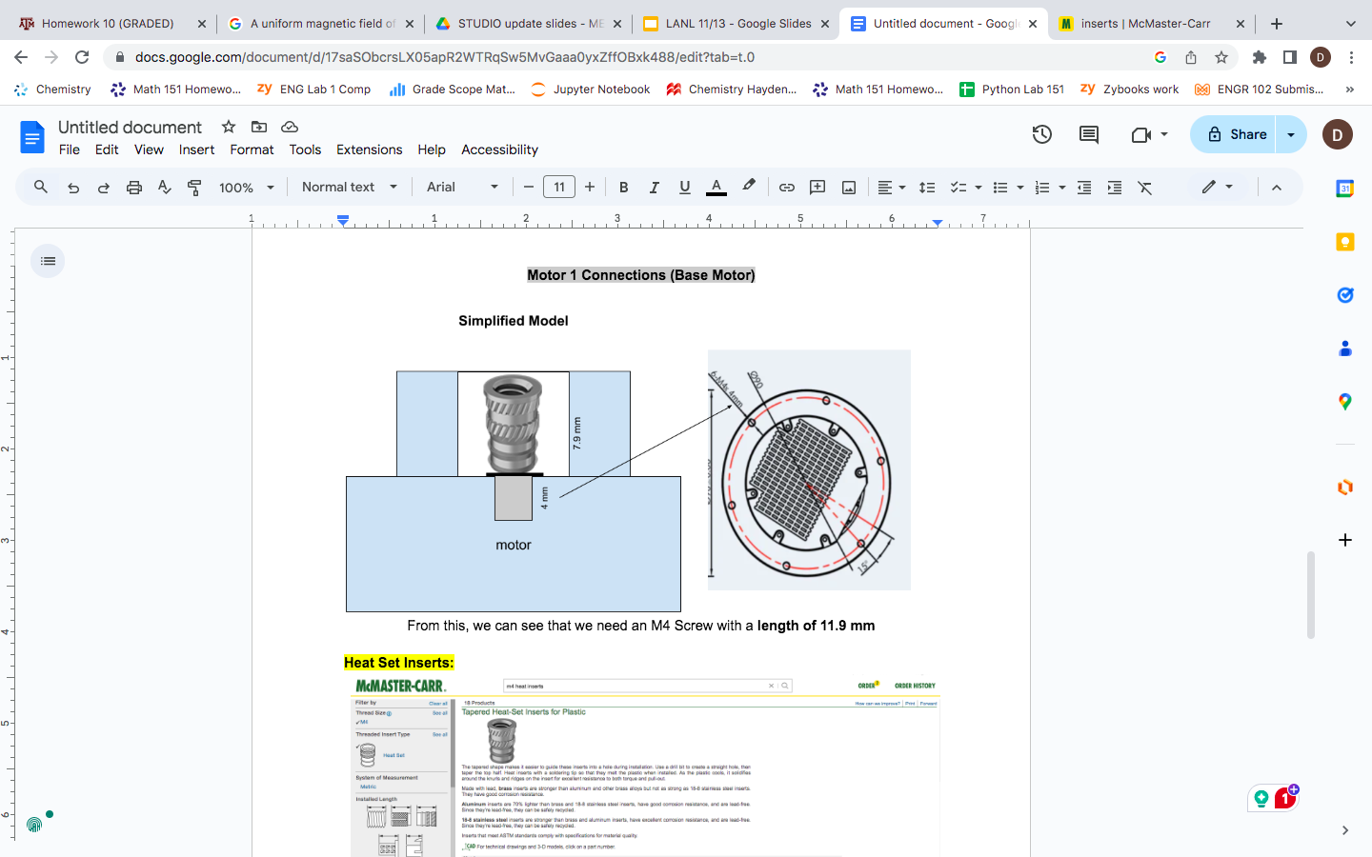
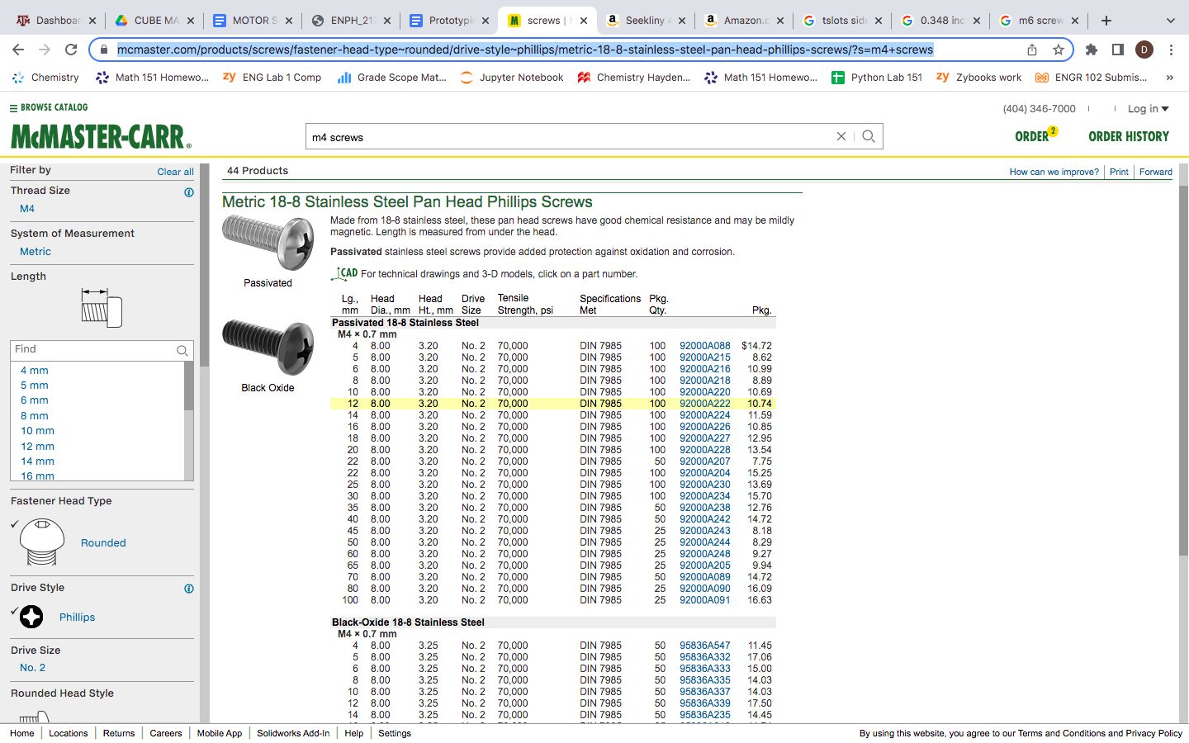
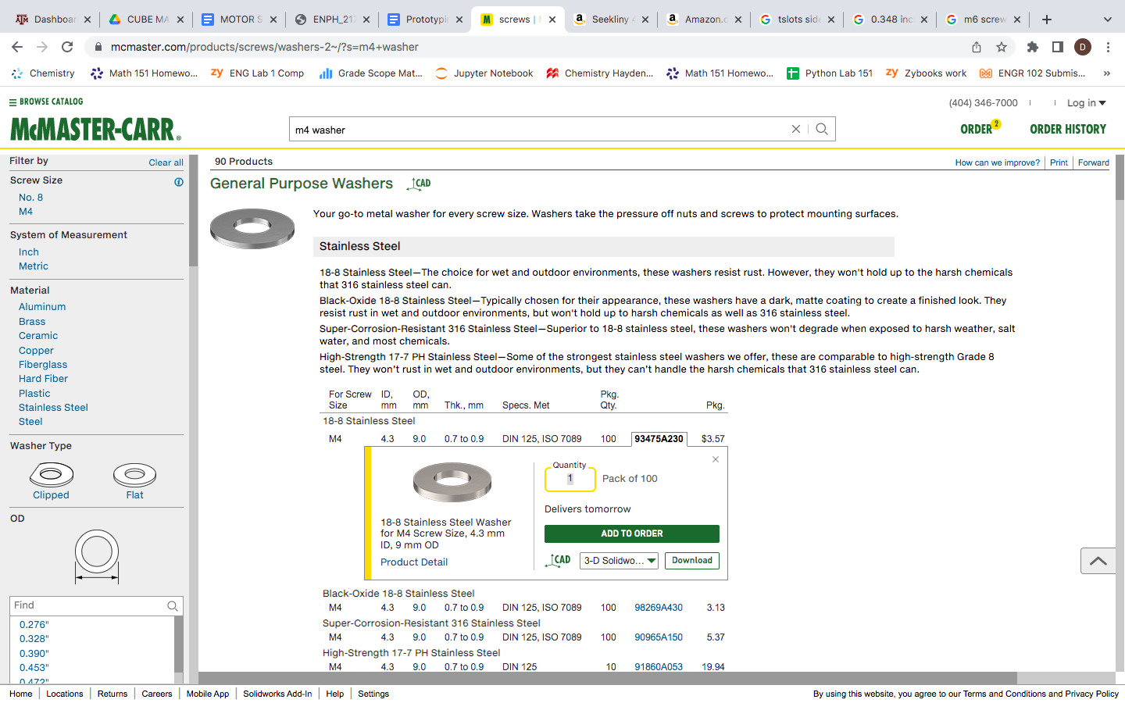
Fasteners
Motor 1 Connection
Notes:
Dalton:
Why we need Heat Set Inserts
Need to be Soldered
Why the screws need to be specific lengths
WHy we need M6 and M4 (compatibility with Different motors and Base)
Fastener analysis huge factor of our design
Talk about Tslot nuts
Why we had to increase to 40x40 Extrusions
You can help explain in the drawings with morgan and Izzy how we plan on securing certain fasteners to motors/3D printed parts

Slide 20
Inverse Kinematics
Talked to Robotics experts and they explained how Inverse Kinematics is possible in SolidWorks
“Transform Tab”- “Interactive IK Mode”
Allows you to directly manipulate an end effector to a desired position
The software will output the necessary joint angles to achieve desired position (Inverse Kinematics)

Slide 21
Upcoming Week
Begin ordering materials for arm
Continue detailed CAD model
Continue working on Design Review 3 materials
Update BOM to reflect any screw/fastener changes

